Slide 1
Week2.5

Slide 2
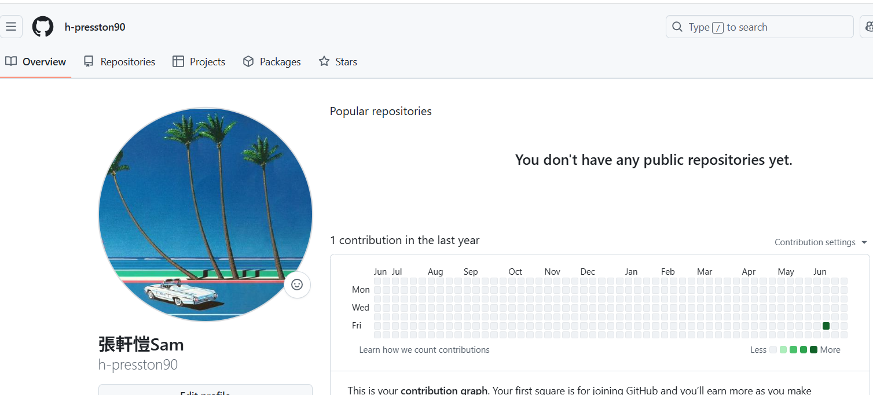
Github
向經理抱歉，拖了一點時間研究該怎麼使用
https://github.com/h-presston90

Slide 3
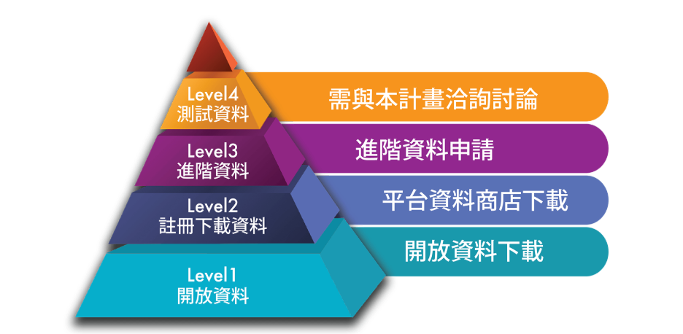
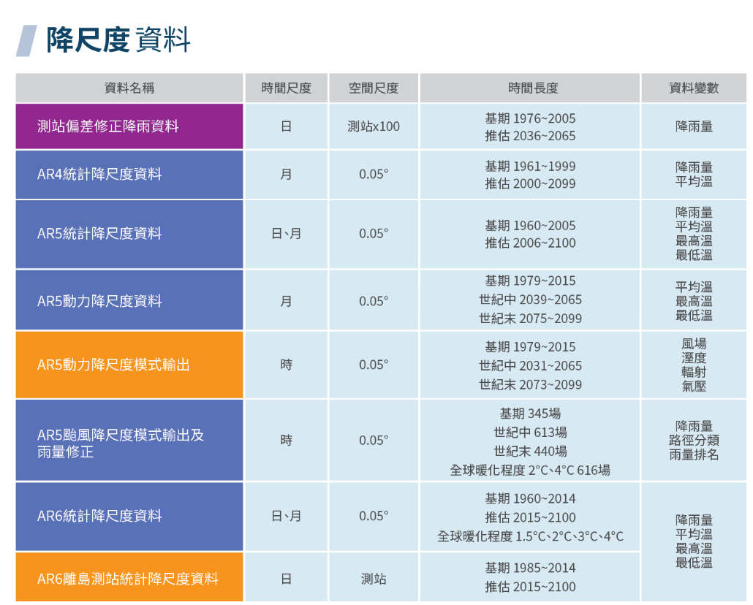
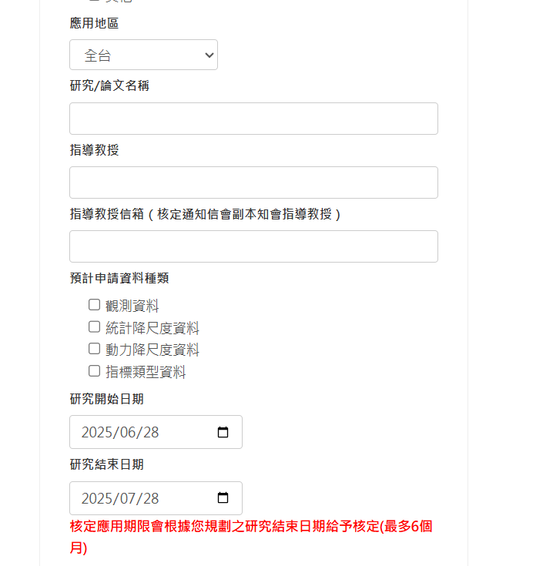
NCDR dataset
原則上當時討論的資料集就屬於網址陳列中的其中一個
相關預測資料針對溫度、降雨，以及氣候現象的重要指標，僅有溫度之部分和key paper 相同
溫度資料屬於level2，可透過正常申請後下載
申請介面需填寫教授姓名與信箱，此外無特殊限制

Slide 4
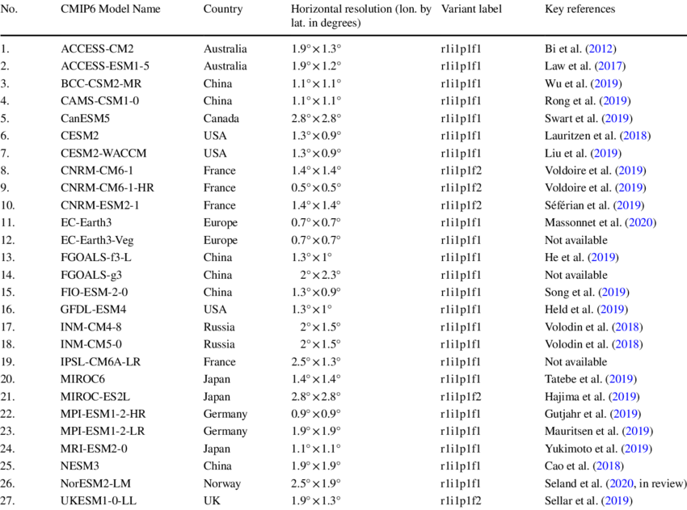
Cmip6 resolution
Paper published in May 2020, outdated
Best resolution is cnrm-hr with 0.5*0.5(apply on cmip6 public website)
A company ”the climate data factory ”claimed that have 0.1*0.1 resolution cmip6 data, haven’t ask for the pricing yet but shall be expensive
https://aims2.llnl.gov/search
As this website shown at meeting, we can search for all model by it’s resolution(next page)

Slide 5
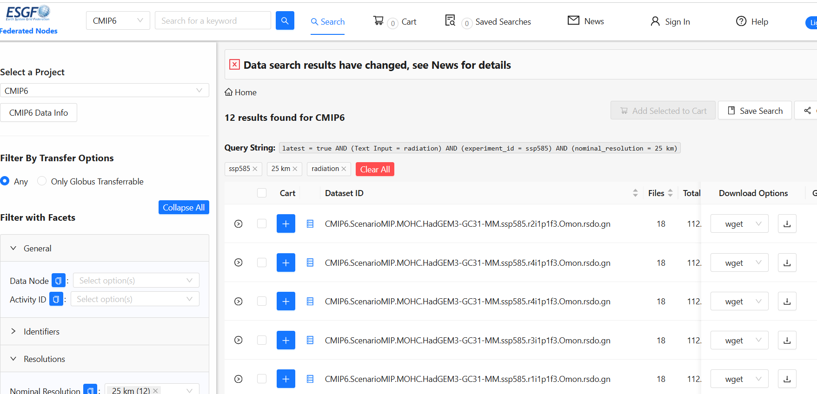
Cmip6 resolution
Have tried on the searching and applying, but the datas are lil tricky to retrieve
Keyword: “ssp58.5+ resolution 25km+radiation”
ssp58.5+ resolution 25km got 1288 results

Slide 6
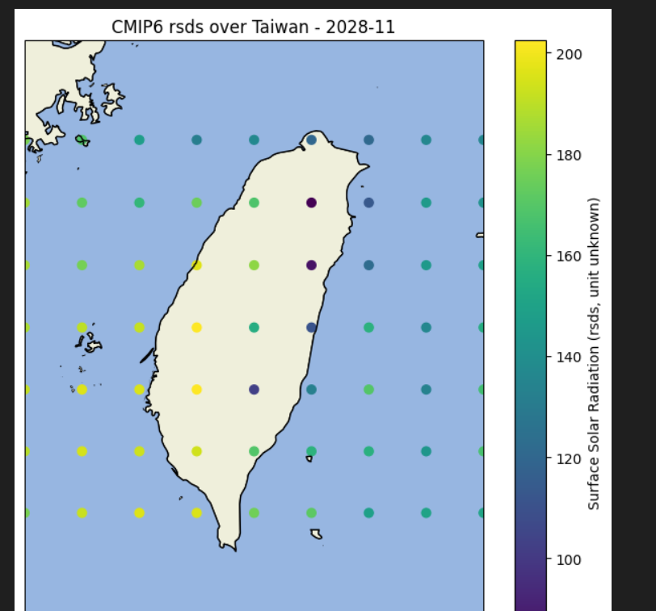
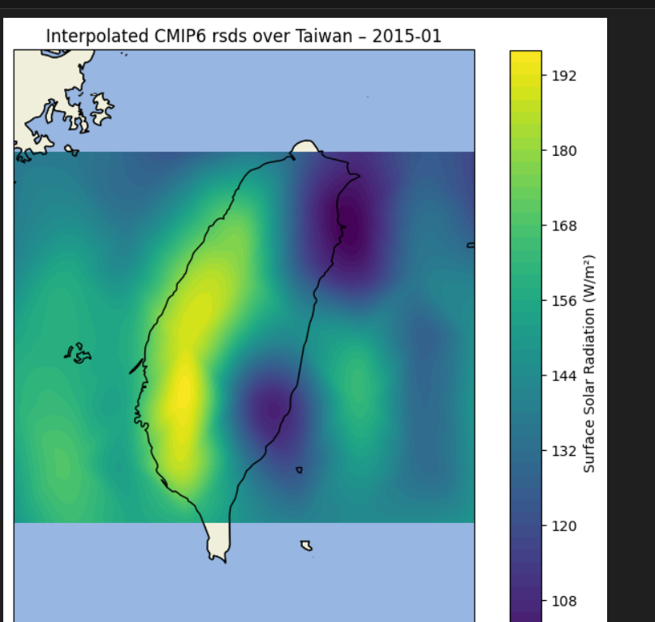
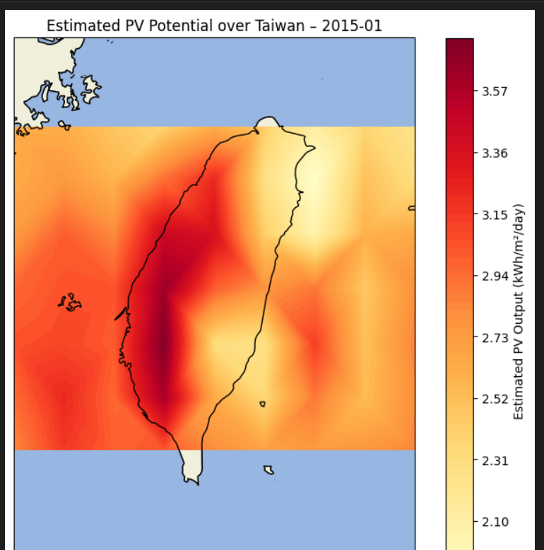
visualization
Have finished the simple plotting at 0.5*0.5 scale, down dwelling radiation
Use basic formula to approximate pvout: df_month["pvout"] = df_month["rsds"] * 0.8 * 24 / 1000
(ssp4.5)

Slide 7
Ongoing works
Exploring a new database retrieval and code fetching
Compare the plot by experiments and the pvout plot by solargis database(will shall the result on next meeting)
Find some precise formula to get the relationship of pvout and radiation
Watching tutorials of github using
Arrange the downloaded papers

Slide 8
Work expected to do(請經理多給建議)
Find a way to make the color plot fully meshed with the boundary
May explore the paper about downscaling, spatial interpolation (inspired by Bing-Zhang Wang, from thu splash)
再請經理可以稍微給一些任務目標

